Slide 1

INFO 7375 — BRANDING & AI · COMPLETE BRAND SYSTEM
Same market intelligence your employer already has.
An adversarial multi-agent AI platform that cross-examines your resume against real DC-metro job postings — and hands you the exact fix, not just a score.
Denis Bykov
INFO 7375 — Branding & AI • Northeastern University
August 14, 2026 · Path B — Madison AI Tool Startup Brand
inquisitive-lily-b52fee.netlify.app
Live brand website · Live tool demo: huggingface.co/spaces/denisbykov/madison-job-intel
1 / 19
Notes:
[~60 sec] Brand Introduction. Say the name, the tagline, and the one-sentence descriptor out loud exactly as written — this is your positioning statement. Don't linger; this slide is a launchpad, not a destination.

Slide 2
BRAND STRATEGY
Job Seekers Have More Tools Than Ever.
Still No Verdict.
$
!
$
32–200+
2–3%
$39.99/mo
Applications the average job seeker sends before landing one offer (2026)
Applicant-to-interview conversion rate industry-wide, down from 8.4% in 2023
Cost of LinkedIn Premium Career — still returns zero fit verdict
%
#
115% more
0.1–2%
interviews for tailored resumes vs. generic ones — tailoring is the lever that works
Success rate of a cold, untailored application with no gap analysis behind it
"Job seekers can see thousands of postings… but can't tell which ones they're actually competitive for."
Sources: HiringThing 2026 Job Application Report · MeetAssist 2026 funnel analysis · LinkedIn pricing verified Aug 2026
BRAND STRATEGY
2 / 19
Notes:
[~35 sec] The real 2026 data — not the debunked '75% ATS rejection' myth. The actual bottleneck is volume + no diagnostic insight, which is exactly the gap Madison fills.

Slide 3
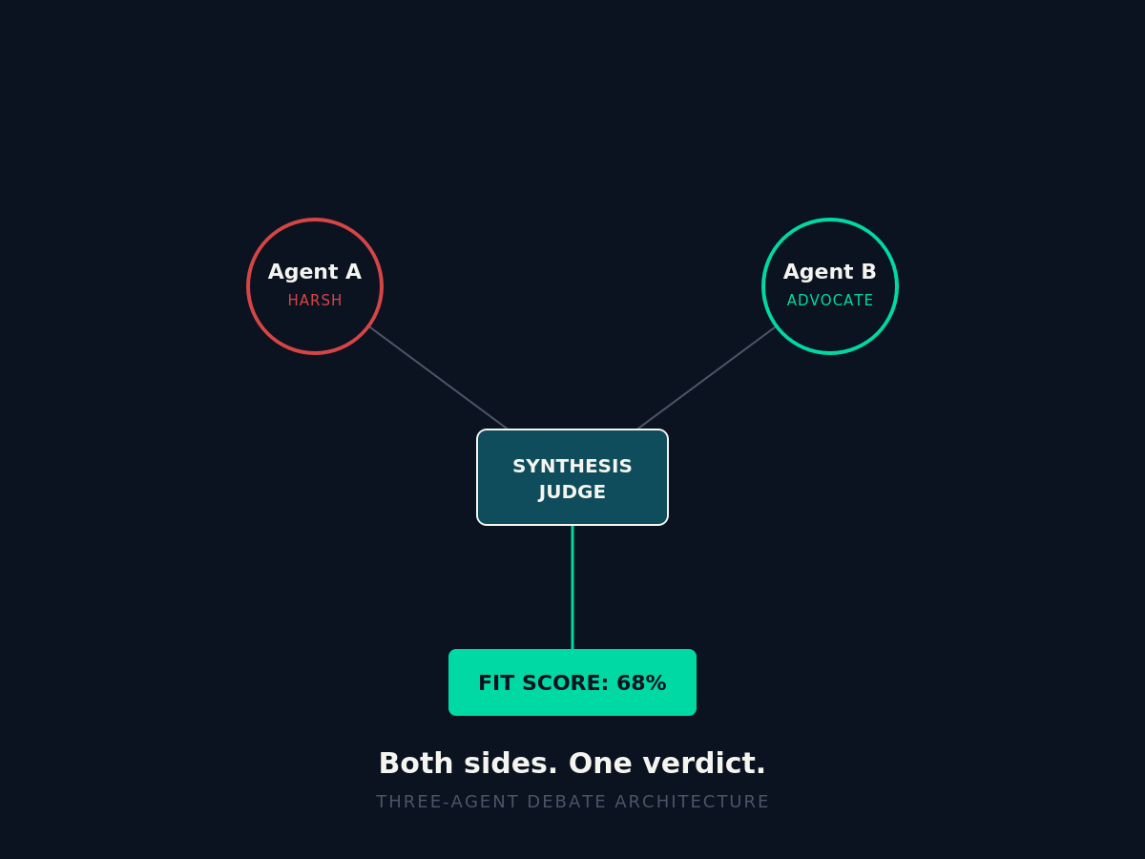
BRAND STRATEGY
You Don't Get a Score.
You Get Cross-Examined.
Upload a resume + target role. Two AI agents debate your fit live. A third delivers the verdict.
AGENT A
Harsh Hiring Manager
Stress-tests every claim on the resume. Flags real skill and clearance gaps — no flattery.
AGENT B
Candidate Advocate
Argues your case. Surfaces transferable strengths Agent A missed.
SYNTHESIS JUDGE
The Verdict
Actual shipped brand visual — Assignment 8
Reconciles both arguments into one fit score, a confidence rating, and a 3-step action plan.
BRAND STRATEGY
3 / 19
Notes:
[~40 sec] This is the core mechanic — adversarial debate, not a single agreeable model. The image on the right is a real shipped brand asset, not a mockup.

Slide 4
BRAND STRATEGY
Five Pillars. One Verdict Engine.
01
02
03
04
05
HONESTY
EVIDENCE
SPEED
ACTION
ACCESS
No AI flattery. An adversarial agent stress-tests every claim.
Every verdict backed by live BLS, NewsAPI, and posting data.
A full diagnostic in seconds — not weeks of silent applications.
Leaves you with a 3-step plan, not just a percentage.
The market intelligence your employer already has — now yours.
These aren't values on a slide. They're the rules the Synthesis Judge runs on.
BRAND STRATEGY
4 / 19
Notes:
[~30 sec] Five pillars, quick — don't read every card verbatim, just hit Honesty and Access since those two carry the positioning.

Slide 5
BRAND STRATEGY
Who We Serve: The DC-Metro Job Seeker
Primary ICP: Early-to-mid career tech & data candidates in DC / Northern Virginia applying to cleared and cloud-infrastructure roles
PERSONA
PERSONA
Priya — The Career-Pivoting Analyst
Marcus — The Cleared IT Specialist
Self-taught data/BI candidate, Junior Data Analyst roles, DC metro
Security-cleared cloud/IT specialist eyeing Leidos, Booz Allen, SAIC
Pain:
Pain:
Applies to dozens of analyst postings with zero signal on why she isn't converting — or which certification actually matters.
Watches cleared roles command a premium he can't quantify against his own resume.
Wants:
Wants:
One clear verdict: is she competitive for this role, and what closes the gap fastest.
Evidence he clears the bar for TS/SCI cloud roles — before he burns a referral.
Key verticals: Federal contracting · Cloud infrastructure · Data analytics · Cybersecurity
BRAND STRATEGY
5 / 19
Notes:
[~35 sec] Two personas, both grounded in the real newsletter content you'll show later — Priya maps to the Junior Data Analyst debate, Marcus maps to the clearance-corridor data.

Slide 6
BRAND STRATEGY
We're Not Another AI Resume Reviewer.
We're the Verdict Layer.
Factor
Generic AI Chat
LinkedIn Premium Career
Madison
Feedback style
Single model, agreeable
Profile visibility stats
2-agent debate + judge
Labor-market grounding
Static training data
Aggregate platform data
Live BLS + NewsAPI + postings
DC-metro / clearance fit
None
None
Built-in (TS/SCI, cloud vs. NOC)
Confidence / fit score
—
—
✓ Fit score + 3-step plan
Access model
Free–$20/mo
$39.99/mo
Free capstone deployment
Positioning: The only tool fusing adversarial AI debate with live regional labor data — built for the DC-metro cleared & tech corridor.
BRAND STRATEGY
6 / 19
Notes:
[~40 sec] Walk the Madison column top to bottom — that's the whole competitive argument in one table.

Slide 7

VISUAL IDENTITY SHOWCASE
Visual Identity System
LOGO
COLOR PALETTE — WCAG-AUDITED
Primary — Dark Background
Ink Navy
Warm White
Signal Green
#0B1220
#F5F5F0
#00D9A3
Variation — Light Background
Deep Teal
Data Amber
Slate Gray
Naming finalists eliminated in trademark/domain clearance: JobSignal · CareerScope · LumenPath · Nexara
#0F4C5C
#F5A623
#4A5568
Every pairing WebAIM-tested — see next slide for verified contrast ratios.
VISUAL IDENTITY SHOWCASE
7 / 19
Notes:
[~40 sec] Logo + light-background variation on the left, full 6-color audited palette on the right. Mention the naming process briefly — shows the strategic rigor behind the final name.

Slide 8
VISUAL IDENTITY SHOWCASE
Type System & Verified Accessibility
TYPOGRAPHY
WEBAIM CONTRAST RESULTS — ASSIGNMENT 8
Calibri
Warm White on Ink Navy
17.11:1
Signal Green on Ink Navy
10.21:1
PRIMARY — Headlines & Interface
Aa Bb Cc 01234567
Data Amber on Ink Navy
9.23:1
Warm White on Deep Teal
8.69:1
Courier New
Slate Gray on Warm White
6.88:1
SECONDARY — Data, Metrics & Scores
7 of 7 pairings pass WCAG AA. 6 of 7 pass AAA — the one exception (Slate Gray captions) still clears AA comfortably and is used only for borders and fine print, never body copy.
68% 14-node $12.98/yr 11.4s
H1 32pt Bold · H2 22pt Bold · Body 14pt · Data 13pt Mono
VISUAL IDENTITY SHOWCASE
8 / 19
Notes:
[~35 sec] Two safe, portable fonts, plus real WebAIM numbers straight from Assignment 8 — every pairing passes AA.

Slide 9
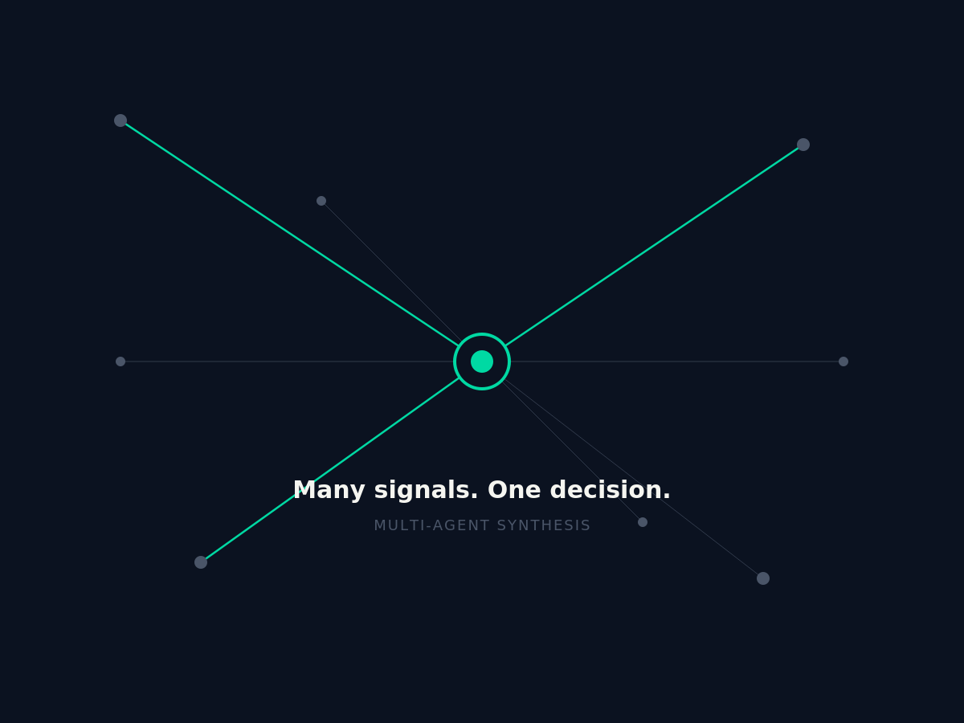
VISUAL IDENTITY SHOWCASE
The Brand Lives Inside the Tool
PRODUCT UI — VERDICT CARD
madison — product interface concept
Junior Data Analyst — DC Metro
Verdict ready · Fit Score 8/10
CompTIA A+
GAP
AWS Cloud Practitioner
GAP
Cross-functional exp.
STRENGTH
Recommendation: apply now — lead with cross-functional project experience.
Actual shipped brand visual — Assignment 8
Same navy. Same signal colors. Same verdict logic — the brand is the interface.
VISUAL IDENTITY SHOWCASE
9 / 19
Notes:
[~35 sec] This verdict card mockup uses the real Junior Data Analyst example from Issue_014 of the newsletter — not invented data.

Slide 10
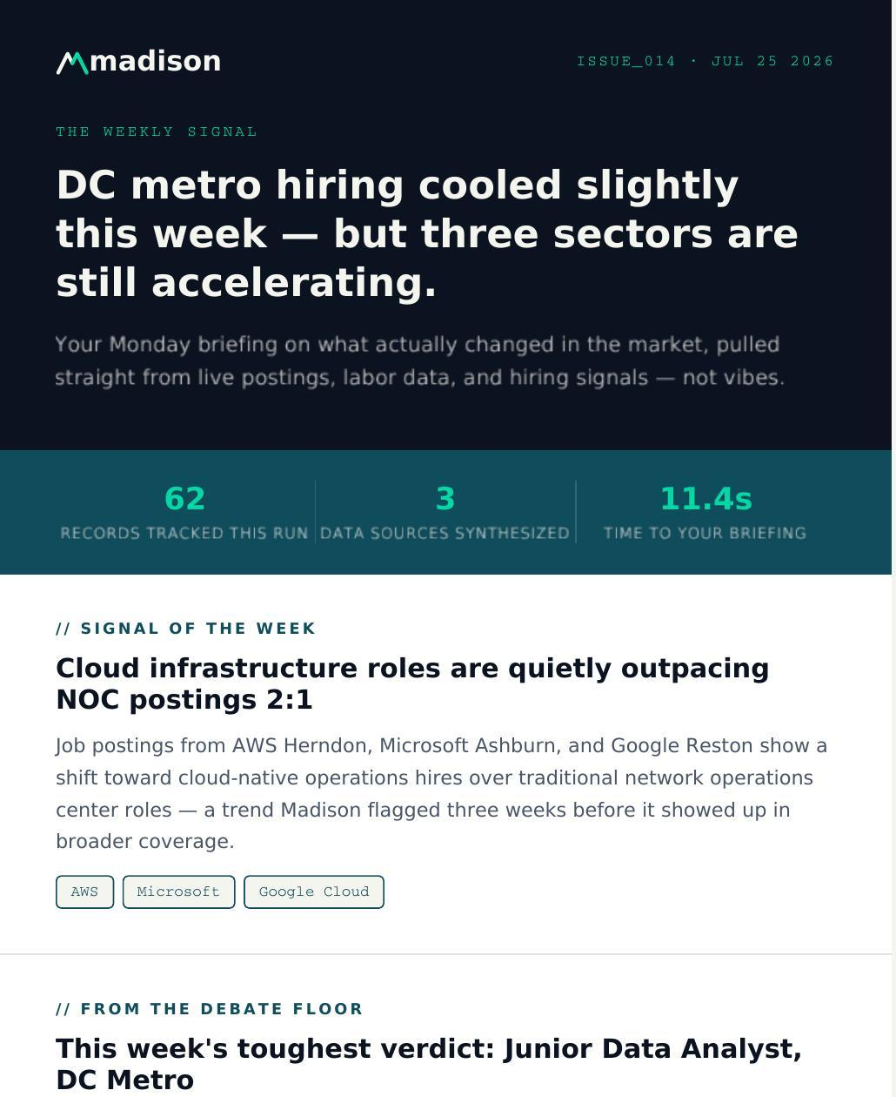
VISUAL IDENTITY SHOWCASE
Brand Voice In the Wild
PRIMARY
SECONDARY
TERTIARY
LinkedIn
Substack
Weekly Newsletter
B2B network, real testers
Long-form origin story
Recurring market signal
in LinkedIn Post
S Substack Article
Most career advice is far too polite.
Why We Built an Adversarial AI Debate Engine to Fix the DC Tech Job Search
It tells you you're a great fit right up until the automated rejection lands. That's why we built Madison — a multi-agent tool that puts your resume through a simulated hiring debate before you apply.
Long-form editorial walking through the debate architecture and the data pipeline behind it — live on Substack.
#AI #CareerStrategy #TechHiring
denisbb.substack.com
lnkd.in/ekBqaMSD · verified, published
VISUAL IDENTITY SHOWCASE
10 / 19
Notes:
[~30 sec] All three are real, published, and linked — not mockups. The right card is an actual screenshot of Issue_014.

Slide 11
BRAND STORYTELLING
Origin Story — The Application That Went Nowhere
FRAMEWORK — HERO'S JOURNEY
1
2
3
4
THE CHALLENGE
THE REALIZATION
THE TRANSFORMATION
THE BUILD
DC tech listings felt like a void — qualified candidates rejected by filters before a human ever saw the resume.
Candidates didn't need more encouragement. They needed to know what a real hiring committee argues about behind closed doors.
We built an n8n pipeline on live BLS data, then ran every resume through an adversarial hiring debate instead of a single polite AI check.
Madison turns passive job searching into an active simulation — surfacing the exact skill and credential gaps standing between a candidate and an interview.
Story → Values: Honesty · Evidence · Speed · Action · Access
BRAND STORYTELLING
11 / 19
Notes:
[~90 sec] Present this one in full — it's Assignment 9, Framework 1 (Hero's Journey), in your own words. Name the framework out loud, then connect the last beat back to the five pillars.

Slide 12
BRAND STORYTELLING
Who We're Solving This For
Every verdict needs a candidate. Ours are DC-metro job seekers applying into silence.
The problem: turning invisible skill gaps into a concrete action plan — before the application goes out, not after the rejection comes in.
PRIYA
MARCUS
Before Madison:
Before Madison:
✗ Applies to 12 analyst postings, hears back from zero
✗ Sees Leidos, Booz Allen, SAIC price cleared roles above the median
✗ Can't tell which certification actually matters
✗ No way to benchmark his resume against the market shift in real time
With Madison:
With Madison:
✓ Runs the Junior Data Analyst debate — lands an 8/10 fit score
✓ Confirms cloud infrastructure roles are outpacing NOC postings 2:1 at AWS Herndon, Microsoft Ashburn, Google Reston
✓ Told point-blank: CompTIA A+ and AWS Cloud Practitioner close the gap fastest
✓ Gets a clearance-corridor verdict instead of a generic "good fit!"
BRAND STORYTELLING
12 / 19
Notes:
[~75 sec] Second story — the use-case transformation. Every number here (8/10, CompTIA A+, AWS Cloud Practitioner, 2:1, the three company names) is real, straight from Issue_014 of the newsletter.

Slide 13
MADISON AI TOOL DEMO
Built, Deployed, and Tested — Not Just Designed
14
62
3
11.4s
3
Node n8n data pipeline
(BLS + NewsAPI + Kaggle)
Records verified at 100%
data quality, 3 sources
Independent AI agents on
live Claude API calls
Average time from upload
to full market briefing
Real users tested live
(Sri, Arjun, Chase)
LIVE ON HUGGING FACE SPACES
denisbykov/madison-job-intel
LIVE WEBSITE
inquisitive-lily-b52fee.netlify.app
CODE
github.com/drippydenis/Madison
User testing conducted live via Zoom, recorded and transcribed with Otter.ai — findings shipped into the next iteration.
MADISON AI TOOL DEMO
13 / 19
Notes:
[~30 sec] This is the transition into the demo section — everything here is shipped and verifiable, not aspirational.

Slide 14
PITCH DECK · SLIDE 1 OF 3
DC-metro job seekers are applying into silence.
They're paying $39.99/mo for tools that still can't tell them why.
32–200+
2–3%
0.1–2%
applications per offer
interview conversion rate
success rate, untailored
MADISON AI TOOL DEMO
14 / 19
Notes:
[~15 sec] Pitch deck slide 1 of 3 — the problem, stated as tight as possible.

Slide 15
PITCH DECK · SLIDE 2 OF 3
Madison cross-examines your resume the way a real hiring committee would.
Then it hands you the verdict.
Adversarial Debate
Live Labor Data
Verdict + 3-Step Plan
Two agents argue your fit — harsh critic vs. advocate.
Grounded in BLS, NewsAPI, and real postings — not static training data.
A fit score, a confidence rating, and exactly what to fix next.
MADISON AI TOOL DEMO
15 / 19
Notes:
[~15 sec] Pitch deck slide 2 of 3 — the product, three features, brand identity visible in the cards.

Slide 16
PITCH DECK · SLIDE 3 OF 3
Shipped in one semester. Built for what's next.
TRACTION
WHAT'S NEXT
✓ 62 records verified at 100% data quality
→ Point getmadison.app at the live site; grow beyond the capstone build
✓ 3 real users tested live via Zoom + Otter.ai
→ Resume auto-rewrite generated straight from the verdict
✓ Deployed publicly on Hugging Face Spaces
→ Grow the Weekly Signal newsletter subscriber base
✓ Live website — inquisitive-lily-b52fee.netlify.app
→ Expand past DC metro into adjacent cleared-role markets
✓ Published Substack article + LinkedIn post
MADISON AI TOOL DEMO
16 / 19
Notes:
[~20 sec] Pitch deck slide 3 of 3 — traction on the left is all real and verifiable, roadmap on the right is honest about scope (independent capstone build, not a funded startup).

Slide 17
MADISON AI TOOL DEMO
How to Use Madison
Tool documentation — feature overview
01
02
03
UPLOAD
DEBATE
VERDICT
Drop in a resume and a target role or job posting.
Agent A and Agent B argue your fit live, grounded in BLS + NewsAPI + posting data.
Get a fit score, a confidence rating, and a 3-step action plan.
FEATURE OVERVIEW
• Multi-source labor data — BLS, NewsAPI, and Kaggle job postings, fused in a 14-node n8n pipeline
• Adversarial two-agent debate + synthesis judge, powered by live Claude API calls
• DC-metro and clearance-corridor tuned — TS/SCI premiums, cloud vs. NOC trend tracking
• Weekly Signal newsletter — recurring market briefings delivered on a schedule
• Gradio interface, deployed and publicly testable on Hugging Face Spaces
MADISON AI TOOL DEMO
17 / 19
Notes:
[~30 sec] This slide doubles as the 1-2 page tool documentation deliverable, condensed for the deck.

Slide 18
LIVE DEMO
Watch the Verdict Land in Real Time
→ huggingface.co/spaces/denisbykov/madison-job-intel
01
02
03
UPLOAD
DEBATE
VERDICT
Resume + target role
Two agents argue live on Claude
Fit score + 3-step plan
Methodology: Live Claude API calls across two adversarial agents plus a synthesis judge, grounded in a 14-node n8n pipeline pulling BLS, NewsAPI, and Kaggle data.
MADISON AI TOOL DEMO
18 / 19
Notes:
[~2-4 min] This is where you switch over and actually run the tool live — upload a resume, show the debate, show the verdict. Narrate the methodology line as you go.

Slide 19
Thank you.
Same market intelligence your employer already has.
WEBSITE (LIVE)
LIVE DEMO
LINKEDIN
SUBSTACK
inquisitive-lily-
b52fee.netlify.app
hf.co/spaces/denisbykov/
madison-job-intel
/in/denis-bykov-
202a72222
denisbb.substack.com
Denis Bykov · INFO 7375 Branding & AI · Northeastern University · August 2026
19 / 19
Notes:
[~15 sec] Close on the tagline, not a Q&A slide — hold for questions verbally.

